Slide 1



MSE Database Support Proposal
April 2021

Slide 2
Contents
Executive Summary
Our Understanding
Our Proposal
Case in Point
Why Persistent ?
Governance Framework
RAIDs

Slide 3
Executive Summary
Intuit MSE BU is looking for a partner to create DBA CoE for support and RTB activities for the IRP and ICP Databases.
Persistent is effectively managing the ICP Database since early 2020 and have successfully delivering key results and process improvements .
Based on additional scope, we are proposing a NEW Multi-Year multi-geographic (Canada & India) delivery strategy including plan to achieve operational excellence, continuous productivity gains, better support, negligible transition risk & automation; at a competitive price point.
Our Proposal include the following:
A Managed Services model for delivery as per the requirement across the IRP and ICP Database
We are proposing 24*7 support model and indicative timeline based on the past ticket analysis trends
To improvise on collaboration and support peak hours, we will strengthen the team for this project having existing Intuit setup
With this well laid foundation, we can leapfrog our journey towards building reliable, consistent and performing Database CoE for Intuit.

Slide 4
Our Understanding

Slide 5
Intuit Revenue Platform
Application Name
Database Name
OFM
ICIS
ERS
CAS
OBill
Obill WEBS
Dbill/ OBILL 10.1
PIM
Rev Stream
IGS
Estore 10.1
aiaprd
wbsvc
tran
casoltp
brmprd
wbsprd01
brm10prd
pimprd01
rvsprd01
MS SQL Server
MS SQL Server
otcprd
icisca
stg
casds
otbprd
icisuk

Slide 6
Intuit Commerce Platform
Application Name
Database Name
RPSP
GSTS
CMDM
Global
EStore
Commerce-Dev
Ecommerce Target
Pre-Prod
IRP NextGen
rpsprd
gstprd
mdmprd
Oracle
Aurora
(MySQL)
Aurora
(MySQL)
Aurora
(MySQL)
vtxprd

Slide 7








Areas of Improvement
Database Monitoring
Replication Monitoring
Diskspace Monitoring
Backup & Recovery
Performance Monitoring
Database Change Request
Cost Saving Measures
Technology Expertise

Slide 8
Problems Identified: Artifacts
Problematic Area | Problem Description | Affected Databases | Root Cause | Impact
Database Monitoring | Database Critical Errors(ORA-00600) | rpsprd021 , wbsprd01 | No automation of monitoring & Health Checks | Possible data loss or data corruption
Replication Monitoring | Replication Issues (Process abended/ Lag/Monitoring) | brm10pdsdb4 , edpprd03 & dsc Prod databases | No Automaton of replication monitoring(Lag/Processes status) No automation of notifications | Downstream applications will have a stale data
Disk Space Monitoring | Archival Destination/ Tablespace/ Mount Point - Full (or) Exceeded Critical threshold | brm10pds, rm10pdsdb4_1 , caiprd01, brm10pdsdb4 , brmpdr2db1, brmqaldb1_1 , rvvss011, CIS, GST Prod & BRM Perf Databases | Not configured (Archive Backups/ Monitoring/ Storage Reclaim) No Monitoring on the threshold-based usage No automation of notifications | Server Downtime Data loss No Capacity planning Database not available
Backup & Recovery | No latest backup available in case of failure | rvssys01 | No constructive policies on backups and recovery | Loss of primary data in case of failure
Performance Monitoring | DB Running Slow | Obill & RevStream Prod databases | No automation of monitoring & Health Checks | Request Time-outs, Application (or) End-user complaints
Database Change Request | Application code includes DDL changes | brmprd | No process to implement the database structure related changes | Replication breakage No tracking/auditing on DB changes
Cost Saving Measures | No Checklist for Re-stacking activity | wbsprd01 | No monitoring on utilization of AWS Services No automation of re-stacking | Over expensive Human Errors Replication Breakage Possible Incident
Technology Expertise | No support for Amazon Aurora (MySQL) | qal-db-cluster.cluster-cnwporauownp | No technical resources available | Unable to provide DB support and handle user requests

Slide 9
Proposed Best Practices
Area of Improvement | TimeLine | Observations/Existing Issues | Proposed Solution/s | Benefit/s
Database Monitoring | Short-Term | DB Hung, Tablespace Full, Long running queries, Locking/Blocking Sessions | Automation of Health Check & Monitoring Scripts. Threshold based Alert Notifications via PagerDuty & Email. | Reduction in the time and resources spent hunting down hidden issues. Improved end-user experiences
Replication Monitoring | Short-Term | Replication Lag, Process Abended | Automation of lag and processes status scripts. Status based Alert notifications via PagerDuty & Email. | Downstream applications will get the latest data
Disk Space Monitoring | Short-Term | Archival Storage Full, Unused Storage, Corruption | Automation of storage reclaim scripts. Storage usage-based Alert notifications via PagerDuty & Email. | Prevents Server Downtime, data loss and failures by being alerted on time More Effective Capacity planning
Backup & Recovery | Short-Term | Scheduled Backups & Retention | Define policies and Automation of backup jobs. Job Completion based Alert notifications via PagerDuty & Email. | Useful in the event of a primary data failure To reconstruct the loss information
Performance Monitoring | Mid-Term | Benchmarks for tuning | Set the performance benchmarks | Ability to troubleshoot performance problems on a proactive basis, before they affect the end user.
Database Change Request | Short-Term | Implementation strategy | Process Implementation for database changes. Ticket based change requests and approvals. | Avoid data corruption by the unauthorized users Auditing/Tracking the DDL changes
Cost Saving Measures | Re-stacking Short-Term(Manual) Long-Term(Automation) | Unused & Underutilized Infrastructure | Analyze the usage and utilization of AWS Services. Usage Threshold based Alert notifications via Email. | Cost-Saving in the infrastructure Avoid human errors Reduction in the time spent
Technology Expertise | Mid-Term | Amazon Aurora (MySQL & PostgreSQL) | Pool of resources with wide range of technologies including AWS RDS, OGG, Aurora(MySQL, PostgreSQL), DynamoDB and RedShift | Ability to support wide-variety of databases and able to handle requests like migrations/upgradations.

Slide 10
Target State FY-22
1
Database Availability
2
Cost — Saving
3
Performance Improvement
100% DB availability
Permanent solutions for issues like DB hung, unavailable to users, No/less space, etc.
Faster resolution of the issues by DBA team
Terminate the unused AWS EC2/ Other services
Release the unused storage space
Downgrade the underutilized services
Pro-active measures by DBAs
Monitoring for effectiveness
Reduction of Noise in the support channels

Slide 11


Effective RTB & CTB Support
Run the Business
24*7 Database Support
Deploying engineers in PST time zone
Peak Season Support
PDS Refresh
Change the Business – FY22
Database Upgradations (Oracle 11g/12c to 19c)
Database Migrations (Oracle to Redshift, MySQL to Aurora)
Re-stacking (Automation)

Slide 12
Our Proposal

Slide 13
Execution Approach
Transition Window 1 Week –Onboarding Starting 1st Jun* 3 Weeks – KT + Shadow Work 2 Weeks Intuit Shadow Independent in ~6 Weeks * 1 Month Investment from PSL for new members | Location of Services Team based out of Canada and India Support in PST and IST time zone | “Follow the Sun” Model Max effort during core business hours Lean Team for weekend support
Further Optimizations Productivity Improvements in terms of effective monitoring, configuration of alerts and notifications Reducing manual efforts for repetitive tasks Proactive Automation | Team Set-Up Oracle /MS SQL Server/AWS Cloud DBAs Work in 3 Shifts Dedicated team Persistent SME Support Core Team with Intuit Experience on Day 1 | Support Window Persistent will provide 24x7 Support Flexible for change in Support Window based on request inflow

Slide 14
Proposed Engagement Roadmap - Guide-Assist-Perform(GAP)
Phase Durations
Starting 1st June
1 Week
3-5 Weeks
3 Months
8 Months
Onboarding
Knowledge Transition
Steady State
Pre-Transition
Knowledge Transition
Stabilization
Independent handling of all in-scope items & minimal Core team support
Maintain minimal backlog on a day-to-day basis
Steady State
Maturity State
Leverage pre-planning to quick start DBA KT along with detailed transition planning. KT framework aims to facilitate and accelerate transition
Incremental Activities
Effective Monitoring of all the databases, replication, storage and performance
Pro Active Identification of Automation Opportunities
Enhancements & Bug Fixes
Team Onboarding
High Level KT Plan
DBA Knowledge Transfer
(3 weeks)
Intuit Shadow and KT Signoff (2 Weeks)
Infrastructure, Staffing, Logistics
Process, Governance, Knowledge Management. Operational Efficiency (MBR/QBR)
Identify and onboard core team High-level transition roadmap Basic infra set up Access provisioning | Detailed transition plan across services KT progress tracking Daily cadence Skill matrix fine-tuning | Completion of knowledge acquisition Playback and validation KT Sign-off Independent operations readiness and sign-off Independent ownership of deliverables | Periodic reviews Continuous interaction with Intuit capability teams Continuous improvement in efficiencies Improved Run Books for faster issue resolutions
Notes:
Add some customization on each section

Slide 15
Intuit Support Process SLAs
Applicable SLAs for Service Requests
Priority: Assigned to service request based on a combination of business impact and urgency | Severity Definition: Expected effort to resolve, measured from BU and customer perspective | Response Time: Time required to assign an appropriate resource to work the issue | Resolution Time: Time required to evaluate and restore lost services (vital business functions)
Critical | Critical business need. Fulfillment of request has great impact on business functions. Highest impact, greatest financial risk/loss. | 7 minutes | Within 3 hours
High | Important business need. Fulfillment of request has a high level of impact on business functions. | 1 hour | Within 8 hours (1 business day)
Medium | Normal business need. Fulfillment of request is important to business functions. | 1 business day | Within 2 business days
Low | Less urgent business need. Fulfillment of request is necessary to business functions. | 2 business days | Within 4 business days
Exact scope and SLAs will be finalized during due diligence/transition phase with mutual agreement.

Slide 16
Proposed Solution — 24 * 7
Maximum support bandwidth planned during the peak hours
Mentioned below the shift hours for 24*7 Support
Lean support during the off-peak hours with flexibility of hours(as needed)
Optimized support during the weekends
Recommended shift timing to cover PST business hours with maximum support bandwidth
Shift Hours For 24/7 Support
IST | Mon | Tue | Wed | Thu | Fri | Sat (On Call) | Sun (On Call)
06:00 AM – 02:00 PM | 2 | 2 | 2 | 2 | 2 | 2 | 2
02:00 PM – 10:00 PM | 2 | 2 | 2 | 2 | 2 | 2 | 2
10:00 PM – 06:00 AM | 4 | 4 | 4 | 4 | 4 | 2 | 2
09:00 AM – 05:00 PM | 1 | 1 | 1 | 1 | 1 | 1 | 1
Recommended team size of 9 : 2 On-Site, 6 Off-Shore and 1 PM
Increased support hours and resilient team size for managing unplanned leaves and backlog management
On Call Support during Weekends
Project Manager to work in the general Shift hours (9AM – 5 PM)

Slide 17
Team Structure
Delivery Partner
[Jeewan Gupta]
Intuit Stakeholders
[Muthu/Manohar/Ramesh]
Project Manager
[Mukesh Puri]
DBA Lead
[Srinivas Pothu]
DBA Lead
[Srinivas Avunuri]
Technical Lead/s
[Chetan]
Azharul
DBA 2
DBA 3
DBA 4
DBA 5
DBA 6
Intuit Exp
Non-Intuit Exp
Intuit FTE
Proposed team size of 2 at this stage

Slide 18



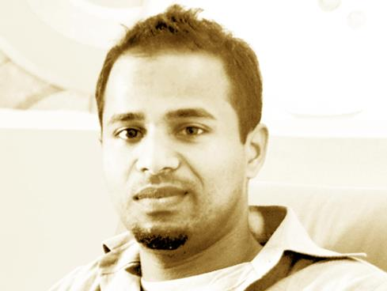
Team Profiles
Raju Sonawane
(Program Manager)
Over 18+ years' experience in Product Engineering, Program and Project and Management.
Delivered Products Solutions across CRM, Mobility, Enterprise Collaboration Platform, Video Analytics, Location- Based Service, Business Intelligence and Analytics.
Mamatha T
(Project Manager)
Certified ITIL V3 Foundation, PRINCE2 Practitioner, Agile Scrum Master.
12+ years' experience in the areas of IT Infrastructure, Release Management, IT Support Operations Management.
Hesam Beigy
(CIP Support Lead)
AWS Certified Solutions Architect, Certified Cloud Computing, Certified Call Center Solutions and System Integrations.
15+ years' experience in Customer Service, Change & operation management, IT Strategies, Continuous Improvement, Lean and Agile Methodologies. Master of Engineering Management.
Avijit Sharma
(Siebel Support Lead)
Certified ITIL V3 Foundation, Certified Siebel 8.x Consultant from Oracle University, Certified Business Analyst from DWBA University. DOEACC 'A" Level certification, Informatica Administrator.
10+ years experience in the areas of IT infrastructure, release management, IT support operations management.

Slide 19
Case in Point

Slide 20
Persistent Experience in Database Projects @ Intuit
Persistent has Global Experience Working in Database Projects across BUs @ Intuit
FACT DB
Worked on database restacking using spinnaker
After spinnaker was decommissioned restacking was getting done manually
Worked on cost optimization and saved more than 4000$ per month
PDS refresh activities
Identity, Desktop Services
Migrated databases from on-prem to AWS RDS with minimum downtime
Automation of OGG restacking using Terraform
Worked on cost saving and reduced cost more than 25% in Desktop services
Started new project in Identity for database support - 100% Ownership of Identity Oracle Database platform support including Prod Environment & 12/7 Support
Siebel
OGG Restacking using Terraform
Performance tuning. One query was taking more than a minute and that was reduced to 10 seconds.
PDS refresh activities

Slide 21
Why Persistent

Slide 22
Why Persistent ?
Pioneer in DBA Support
Persistent has experience in database support projects across Intuit BU’s.
Currently working on Identity Platform 1.0 DBA Support Project, FACT DB, Siebel
Program Readiness
We have DBAs worked on Intuit projects and aware about Intuit process and policies
Value Adds
Work continuously on cost saving wherever possible
Fix/Workarounds of recurring issues to reduce the noise
Keep documentation & inventory up to date on Wiki
Collaborative Engagement
Strategic Partner for Intuit since the last 13+ years
Have successfully delivered more than 100+ projects across BUs including Managed L1/L2/L3 support
Multiple Geo Coverage
Persistent team spreads across India and Canada
Persistent ODC in India is located within 100 meters from Intuit IDC
Proposed team will be based out of our ODC only
Governance & Compliance
Regular MBR with the Intuit Managers
Consistent Average NPS >= 9 for last 4 months across various projects including Identity DBA Project.

Slide 23
Governance Framework

Slide 24

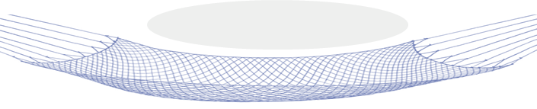
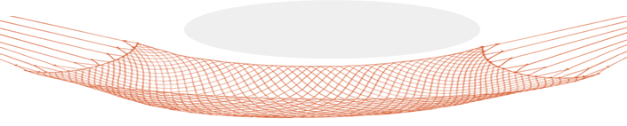
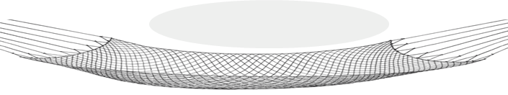
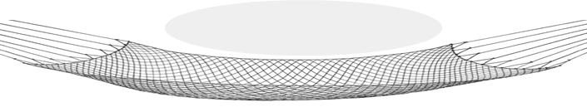
Governance ‘Safety Nets’
President (Technology Services)
Executive Sponsor
Business KPI Review
RELATIONSHIP REVIEW
Account Leadership
Escalations/Issue Resolution
Intuit MSE Leadership
QBR/MBR/ Weekly
Account Management
Customer Escalations
Engineering Leads
Delivery
Manager
Program Manager
DBAs
Architect
SLA Breach
PLANNING MEETINGS
Daily
Robust governance ‘safety nets’ designed for proactive tracking and mitigation

Slide 25
Program Governance Model
Risk Mitigation |  |  | Value Realization
Risk & Compliance Management | Contract Management | Change Management |  | Service & Quality Management | Relationship Management
Tier | Strategic |  | Operational |  | Tactical
Function | Strategic Guidance |  | Advise, Direct, and Resolve |  | Plan, Manage, and Drive
Stakeholders | Intuit Sponsors & Persistent Leadership |  | Intuit Function Lead and Persistent Delivery Partner |  | Intuit Function Lead and Persistent Application Lead
Frequency | Quarterly |  | Monthly |  | Weekly
Key Responsibilities | Align strategic direction and goals of the engagement Long-term planning/partnership view Monitor and resolve executive level issues |  | Review performance against contractual commitment Metric tracking SPOC for all issues Delivery ownership and program coordination |  | Day-to-day work definition Day-to-day delivery Measurement of metrics and reporting
Escalation | Unresolved sponsor level issues | Unresolved issues requiring senior attention |  | Issues not resolved within a week |  | Issues tracked daily

Slide 26
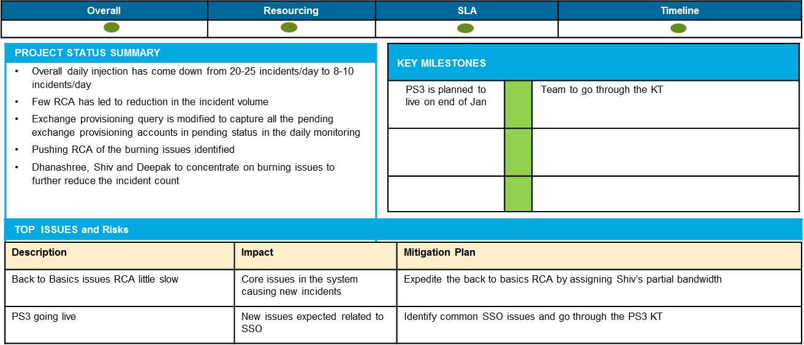
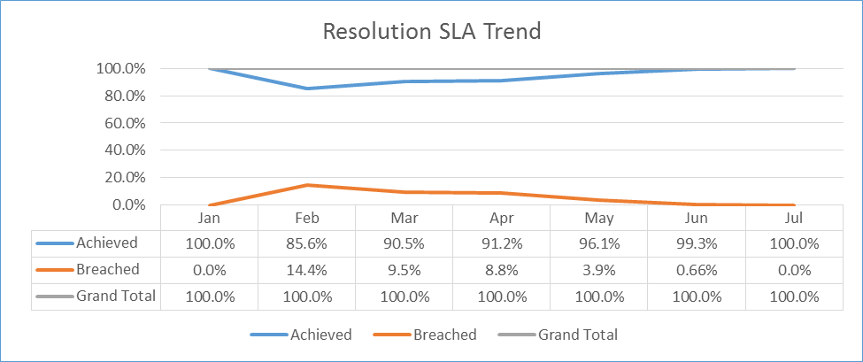
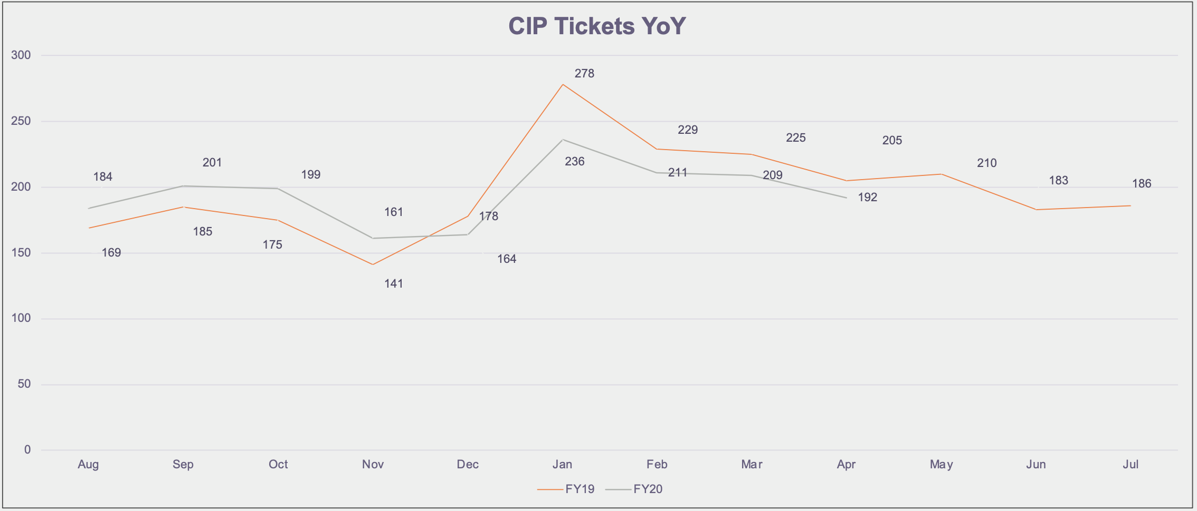
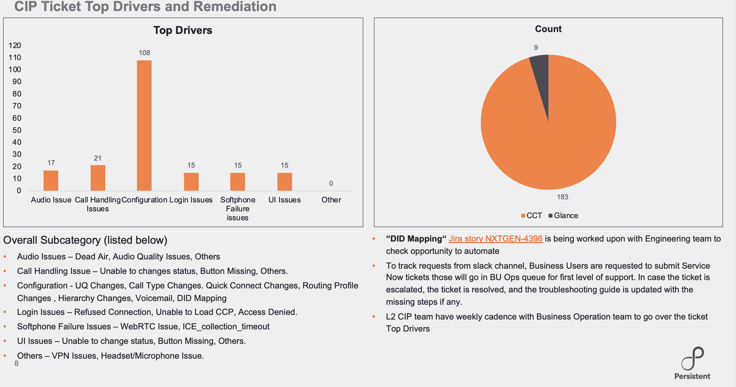
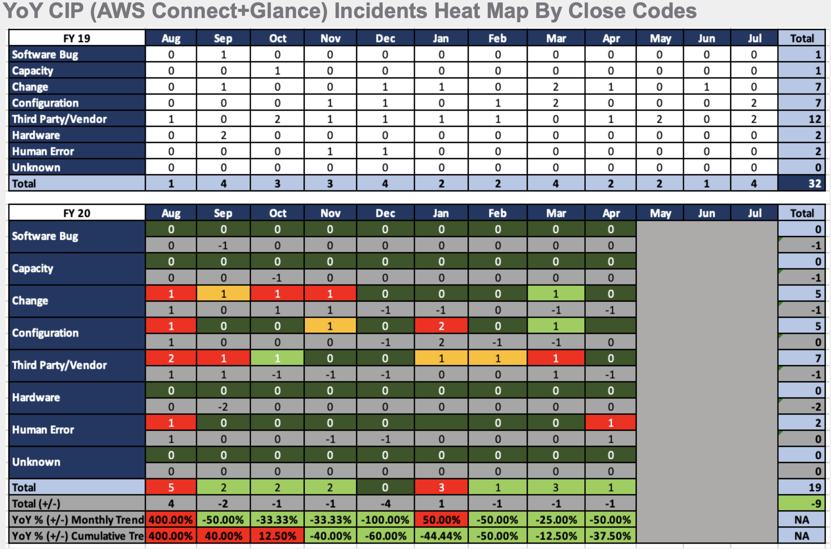
Sample Online Dashboards
Persistent will create these ONLINE dashboards for the Senior Stakeholders
Overall Monthly Status
Monthly SLA Performance`
Indicative Dashboards
Notes:
Mention 1min- Delivery

Slide 27
RAIDs
Risk, Assumptions, Issues & Dependencies

Slide 28
RAIDs Logs
SL # | Type | Description | Mitigation Plan
1 | Risk | Full team capacity may not be onboard at start COVID Impact – Lack of Physical Onsite presence for KT Unexpected delays during KT schedule Low Productivity Lower Capacity during unplanned leaves | Plan for capacity + 10% team size Strengthen KT Plan, defined toll gates, leverage video conferencing, collaboration tools, recorded sessions Daily tracking of completion of activities and escalation within 24 hours, in case of delay and the resolution to be worked upon jointly as part of KT framework Persistent SME Support or Increase team size to bring up productivity Proposed model handles unplanned leave scenarios
2 | Assumptions | If any travel is required, it will be billed at actuals to Intuit Team Sizing based on current visibility | Prior approval will be taken from Intuit Manager Discuss with Intuit Team and flexible for any team size needed
3 | Dependencies | Knowledge Transfer from CTS Hardware/Software Knowledge Base | Current CTS Team to provide the needed Knowledge transfer as per plan Intuit Team to ship the needed hardware and provide access to the teams in India. Team to start with Persistent laptop in the interim Intuit Team to provide access to the current knowledge base & environments

Slide 29

THANK YOU
Statement of confidentiality: This document is being submitted to Intuit by Persistent with the explicit understanding that the contents would not be divulged or shared with any third party without prior written consent from Persistent. All other company logos or product names mentioned in this proposal are used for identification/illustration purposes only and may be trademarks of their respective owners. The contents of this document or any information subsequently provided whether verbally or in writing or any other form in relation to this document (“Response”) is subject to a written contract mutually negotiated and signed by authorized signatories of both parties. The estimates of performance, delivery time or cost in Response are preliminary estimates based on the information available on the date of the Response. Further information and detailed analysis may cause preliminary estimates to vary.

